Slide 1
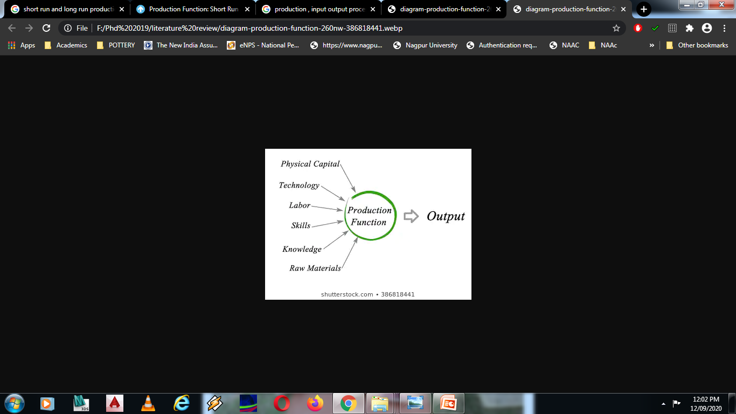

Slide 2
What is the Production Function?
The functional relationship between physical inputs (or factors of production) and output is called production function.
It assumed inputs as the explanatory or independent variable and output as the dependent variable. Mathematically, we may write this as follows:
Q = f (L,K)
Here, ‘Q’ represents the output, whereas ‘L’ and ‘K’ are the inputs, representing labour and capital (such as machinery) respectively. Note that there may be many other factors as well but we have assumed two-factor inputs here.

Slide 3
Law of Variable Proportion
Keeping other factors fixed, the law explains the production function with one factor variable. In the short run when output of a commodity is sought to be increased, the law of variable proportions comes into operation.
Definitions:
“As the proportion of the factor in a combination of factors is increased after a point, first the marginal and then the average product of that factor will diminish.” Benham

Slide 4
Law of variable proportions is based on following assumptions:
(i)The state of technology is assumed to be given and constant. If there is an improvement in technology the production function will move upward.
(ii)The law assumes that factor proportions are variable. If factors of production are to be combined in a fixed proportion, the law has no validity.
(iii)The units of variable factor are homogeneous. Each unit is identical in quality and amount with every other unit.
(iv)The law operates in the short-run when it is not possible to vary all factor inputs.

Slide 5
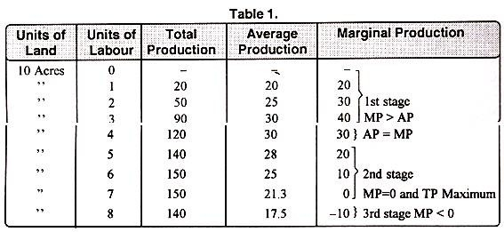
Explanation of the Law:
In order to understand the law of variable proportions we take the example of agriculture.
Suppose land and labour are the only two factors of production.
AP = TP/L
MP = TPn – TPn-1

Slide 6
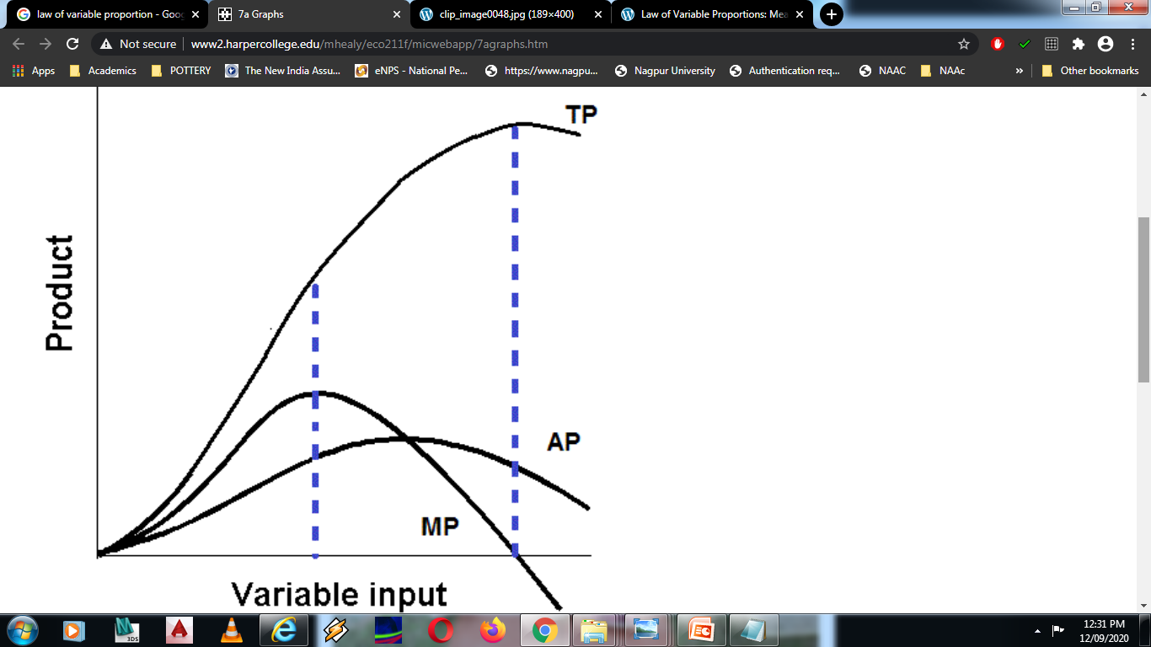
Stage 3
Stage 1
Stage 2

Slide 7
Stages /Product | Stage 1 : Increasing Marginal Return | Stage 2 : Diminishing Marginal Returns | Stage 3: Negative Marginal returns
Total (TP) | Increases at an increasing rate | Increases at diminishing rate | Diminishes
Average (AP) | Increases at a gentle rate compared to MP | Decreases at a steady rate compared to MP | Falls but remains positive
Marginal (MP) | Increases at a rapid rate compared to AP | Diminishes at a Rapid rate in comparison to AP | Becomes Negative

Slide 8
Rational Decision:
Stage II becomes the relevant and important stage of production.
Production will not take place in either of the other two stages. It means production will not take place in stage III and stage I.
A rational producer will always produce at stage 2 where both average & Marginal product are diminishing, as here he will be utilizing properly both fixed and variable factors.

Slide 9
Limitations of Law of Variable Proportion.
The law assumes that there will not be any improvement in agricultural technology however agriculture is always subject to improve methods of cultivation.
This law will not operate if it is not possible to keep some factors fixed .
The law fails to operate if the variable factors are not homogenous.

